Slide 1

Solar Tracker Project
Jamie A. Back
Cincinnati Country Day School
Honors Geometry, Grade 9

Slide 2
Big Idea:
Solar Energy
Essential Question 1
Essential Question 2
How can we make a solar panel installation most effective and efficient in any location?
Essential Question 4
Essential Question 5
Challenge:
Design a solar tracking device that moves solar panels throughout the day so that they optimize sun’s energy.
Guiding
Questions:
How does the sun's position in our sky change
How can we predict the position of the sun in the sky?
How do solar panels capture the sun's energy?
What is the best angle to install solar panels?
How do we measure “optimizing energy”?

Slide 3
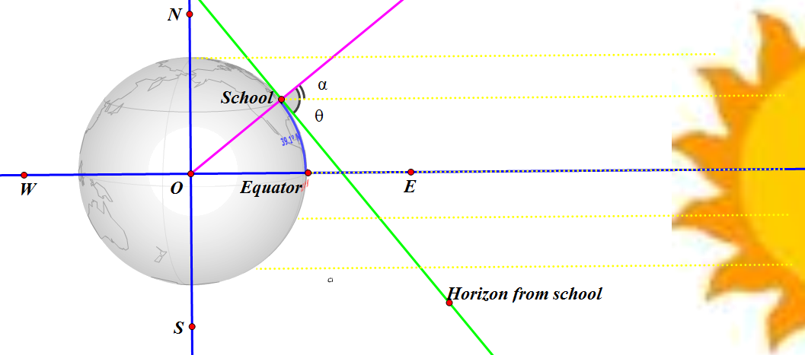
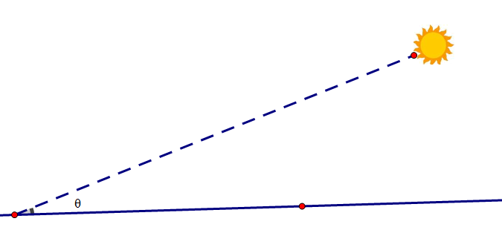
Academic Content
Modeling with Geometry
Use geometric shapes, measures, and properties to describe objects; Apply geometric methods to solve design problems
Geometric Measurement and Dimension
2D vs 3D relationships
Expressing Geometric Properties with Equations

Slide 4
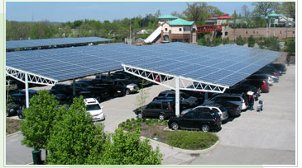

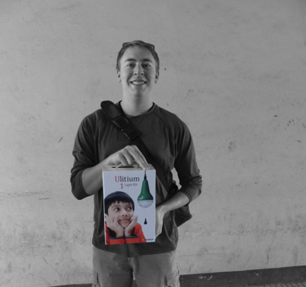

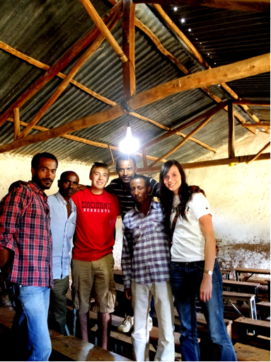
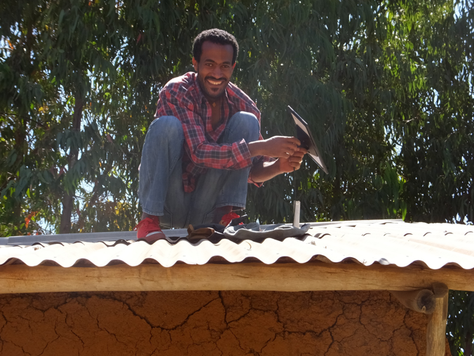
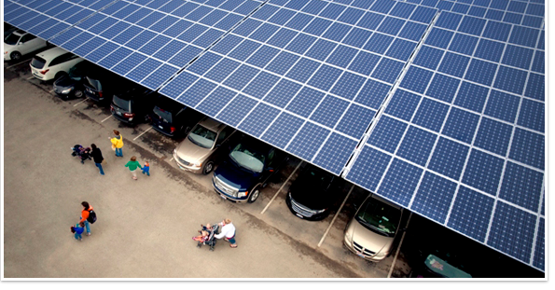
Real World Applications, Societal Impact, and Career Awareness

Slide 5
Data Analysis: Evidence of Student Learning
Pre-Assessment
Average Score: 61%
Post-Assessment
Average Score: 79%
Pre-Assessment
Average Score: 61%
Post-Assessment
Average Score: 79%
Pre-Assessment
Average Score: 61%
Post-Assessment
Average Score: 79%

Slide 6
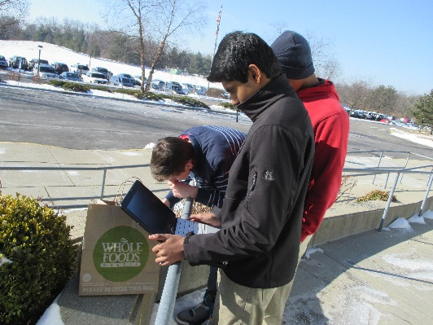
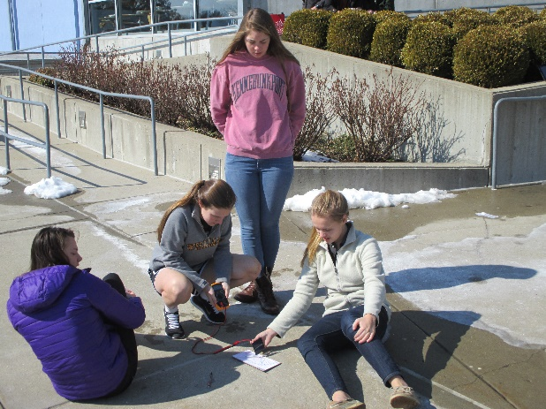
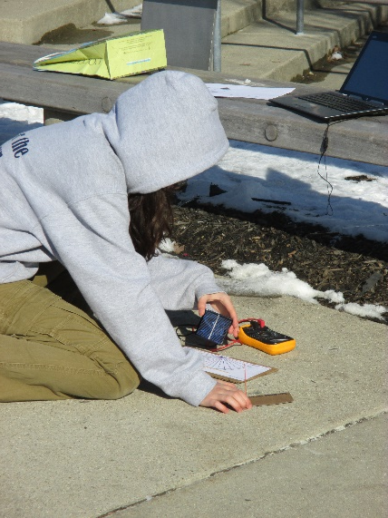
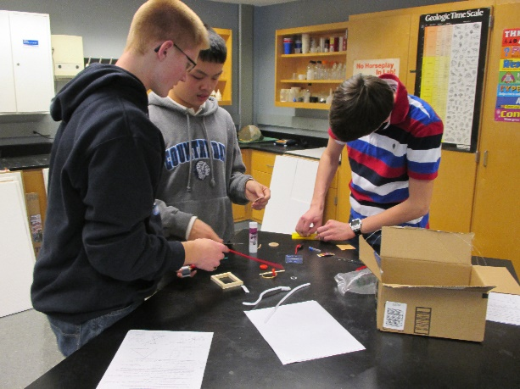
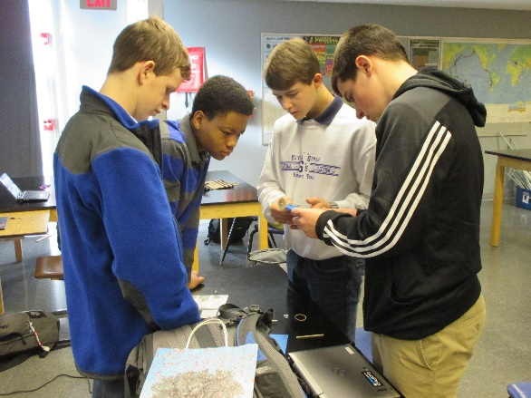
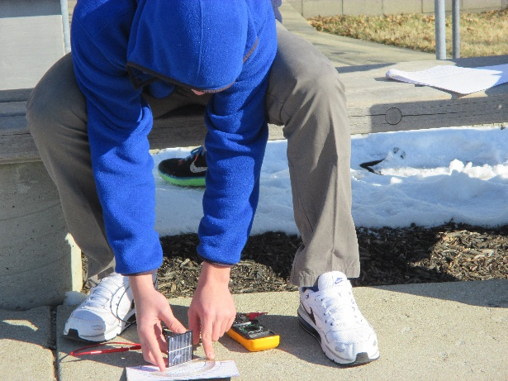
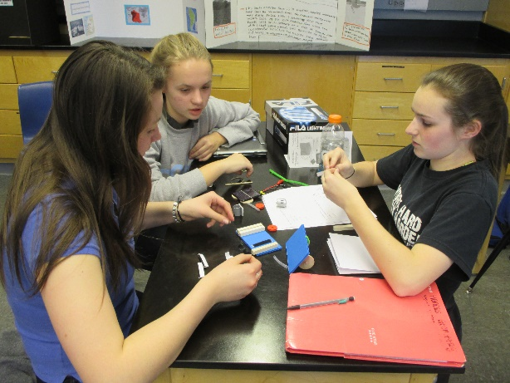
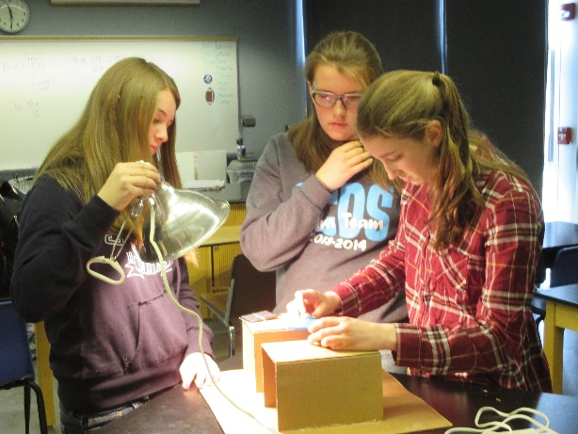
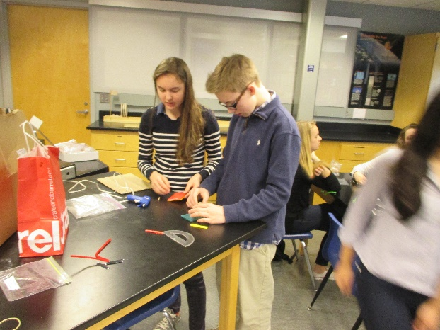
Activities
What’s the Big Idea?
Where is the Sun?
Angles Matter
Challenge!

Slide 7
Reflections
Students comfortably used solar vocabulary with peers.
Students were surprised that simple geometry could find solar altitude.
Students were highly engaged during the unit.
Groups continuously tested and refined their devices and were able to determine the impact of design changes.
Most groups used only one solar panel; most devices moved too fast. Result: Added an activity.
Some students had difficulty finding the best surface azimuth and tilt angles for stationary solar installations. Result: Refined student questions.

